Slide 1
Macbeth
by
William Shakespeare
Dr. Archana Gupta, Asso. Prof. English

Slide 2
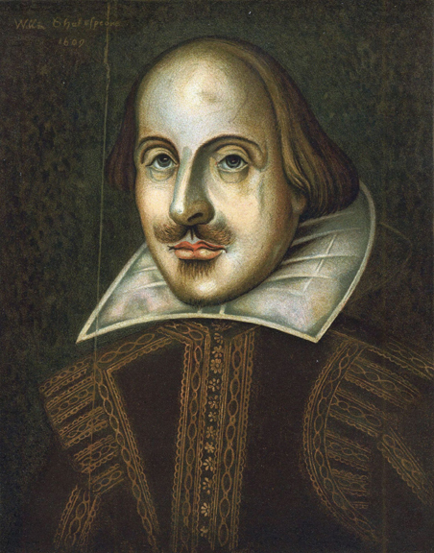
Life of a Playwright
During Shakespeare’s days, the life of a playwright was hardly deemed worthy!
The years between his marriage and departure for London are called the “Lost Years.” Little known about what he did.
First gained status when he performed for Queen Elizabeth I (with whom he was very popular)
By 1594 six of his plays were written and produced.
Notes:
2

Slide 3
Originally, his plays were not written to be read as literature, but as consumable materials.
Manuscripts were not circulated due to the fact that the content could be stolen and this was their livelihood.
It is a known fact that Shakespeare borrowed widely from many sources.
1594 He performed and wrote for a group of actors called the Lord Chamberlain’s Men.
Most of his performances were done for royalty.
Notes:
3

Slide 4
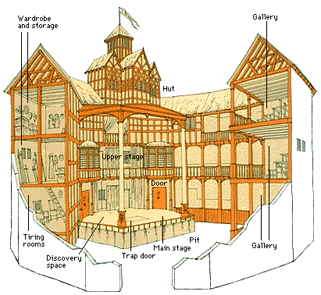
The Globe Theater 1599
Burned in 1613
Notes:
4

Slide 5
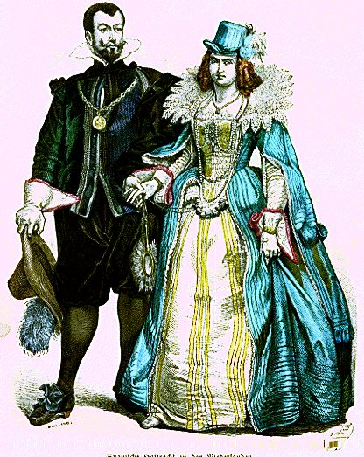
When in a play...
Only men were permitted to perform
Boys or effeminate men were used to play the women
Costumes were often the company’s most valuable asset
Costumes were made by the company, bought in London, or donated by courtiers
Notes:
5

Slide 6
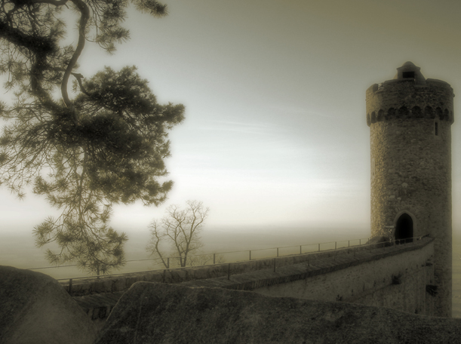
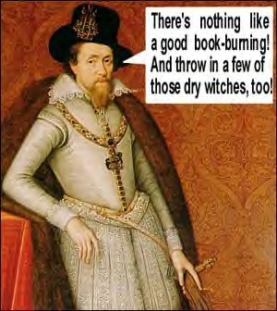
Macbeth: The Historical Context
Macbeth is supposed to have been written sometime between 1603 and 1606, after The King’s Men gained King James’s patronage.
It is the play which best represents the relationship between Shakespeare and the King.
King James claimed to be a descendant of Banquo, with only eight kings in between them.
James was also famous for his obsessions with the Divine Right Theory and with witchcraft, two big themes that Shakespeare incorporates into the play.
King James I
Notes:
6

Slide 7
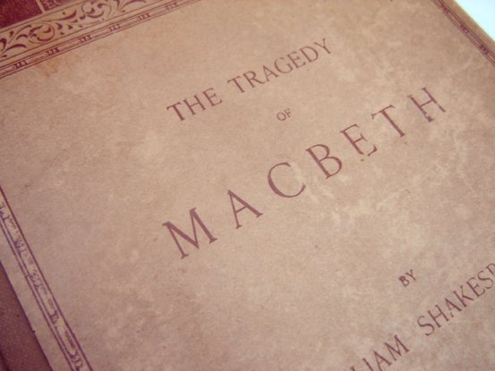
Historical Context, Continued…
Shakespeare took the basic story of Duncan and Macbeth from Hollinshed’s Chronicles, which dates the reign of these two Scottish monarchs between 1034 - 1057.
Because he had to please his patron, Shakespeare made the character of Macbeth much more villainous than he probably was. (Shakespeare used the same flattery to please his Tudor patrons in Richard III)
Notes:
7

Slide 8
King Duncan of Scotland- Honest and good
Malcolm & Donalbain -Sons of the King, Malcolm is the eldest son
Macbeth -Duncan’s most courageous general
Ambition to become king corrupts him
Banquo -General and Macbeth’s best friend
Lady Macbeth -As ambitious as her husband
A dark force behind his evil deeds
Macduff -Scottish general, kills Macbeth
Notes:
8

Slide 9
Supernatural forces
Wiches- three weird sistes
Hecate
Aparitions
The ghost of Banquo

Slide 10
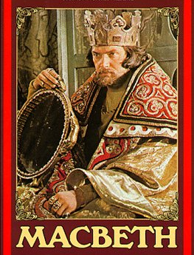
Tragic Hero
Def. “Man of high standard who falls from that height because of a flaw that has affected many” - Aristotle
Macbeth is one of the most famous examples of the tragic hero.
Notes:
10

Slide 11
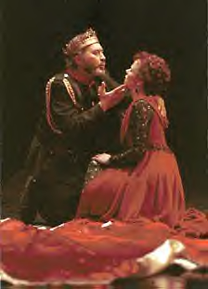
So what really happens?
Good man goes bad
He wants power
Married to a wicked lady
She also wants power
Kills many people
Gets power
Gets paranoid (a.k.a. goes crazy)
He meets his downfall at the end
Notes:
11

Slide 12
Tragedy (Shakespearean)
Drama where the central character/s suffer disaster/great misfortune
In many tragedies, downfall results from>
Fate
Character flaw/Tragic flaw
Combination of the two

Slide 13
Soliloquy
Long speech expressing the thoughts of a character alone on stage.
Aside
Words spoken, usually in an undertone to the audience not intended to be heard by all characters

Slide 14
Dramatic Irony
A contradiction between what a character thinks and what the reader/audience knows to be true

Slide 15
Verbal Irony
Words used to suggest the opposite of what is meant
Situational Irony
An event that directly contradicts the expectations of the characters, the reader, or the audience

Slide 16
Comic Relief
Use of comedy within Tragedy in order provide “relief” from seriousness or sadness.
In Macbeth the Porter scene provide comic relief .

Slide 17
Theme
Good vs. Evil
Ambition

Slide 18
Poetic Justice
The idea virtous should be rewarded and vice should be punished. Poetic justice has been employed in Macbeth.

Slide 19
Thanks

